Slide 1

RideWise Customer Analytics
& Churn Prediction System
OLUWATOSIN ABRAHAM
Data Analytics & Machine Learning
24/07/2026

Slide 2
Problem Statement
Rider churn increases acquisition costs and reduces long‑term revenue.
The business lacks a data‑driven method to identify riders at risk of churn.
Objective:
Predict churn probability for each rider.
Identify the behavioural, engagement and loyalty of riders.
Segment riders for targeted retention.
Provide actionable insights for marketing and operations.

Slide 3
What the system delivers
OBJECTIVES
Customer churn prediction
Real-time scoring API
1
5
Rider segmentation
MLflow tracking
2
6
Feature engineering pipeline
Monitoring & dashboarding
3
7
Model interpretability
4
RideWise Analytics
02
Notes:
RideWise aims to reduce customer churn and improve rider retention.
I was able to build a rider‑level analytical dataset combining demographics, behaviour, and engagement.
Exploratory Data Analysis reveals clear churn drivers: engagement, trip frequency, and loyalty tier.
A machine‑learning model will predict churn risk and support targeted retention strategies.
Segmentation identifies distinct rider groups for personalised interventions.

Slide 4
Core data entities
DATA ARCHITECTURE
Riders sit at the centre, enriched by behavioural, engagement and performance data.
Riders
Trips
Sessions
Drivers
Promotions
Primary entity
Behavioural features
Engagement features
Performance features
Optional features
Riders_ml = One row per rider
Demographics, loyalty status, behavioural aggregates, engagement metrics, churn probability
RideWise Analytics
03
Notes:
Trips aggregated into behavioural features:
total_trips, avg_fare, avg_tip, avg_surge, last_trip_time
Sessions aggregated into engagement features:
total_sessions, avg_pages_visited, conversion_rate
Final dataset: 17 features, 10,000 riders
Why this matters: Churn prediction is a customer‑level problem, not a trip‑level problem.

Slide 5
Core data entities
DATA ARCHITECTURE
Riders sit at the centre, enriched by behavioural, engagement and performance data.
Riders
Trips
Sessions
Drivers
Promotions
Primary entity
Behavioural features
Engagement features
Performance features
Optional features
Riders_ml = One row per rider
Demographics, loyalty status, behavioural aggregates, engagement metrics, churn probability
RideWise Analytics
03
Notes:
Trips aggregated into behavioural features:
total_trips, avg_fare, avg_tip, avg_surge, last_trip_time
Sessions aggregated into engagement features:
total_sessions, avg_pages_visited, conversion_rate
Final dataset: 17 features, 10,000 riders
Why this matters: Churn prediction is a customer‑level problem, not a trip‑level problem.

Slide 6
From raw data to ML-ready dataset
ETL PIPELINE
01
02
03
04
05
Cleaning
Merge Strategy
Aggregation
Feature Engineering
ML Dataset
Validate, duplicates,,datatypes, handle missing values
Join entities on rider keys.
Roll up trips, sessions, promotions
Derive behavioural signals
Point-in-time training tables
RideWise Analytics
04

Slide 7
What the data reveals - EDA
EDA INSIGHTS
Rider behaviour patterns
Usage frequency and recency drive value.
Engagement trends
App sessions decline before churn.
Churn correlations
Engagement + behaviour = core features for modelling.
.
Key visualisations
Distributions and outliers.
RideWise Analytics
05

Slide 8
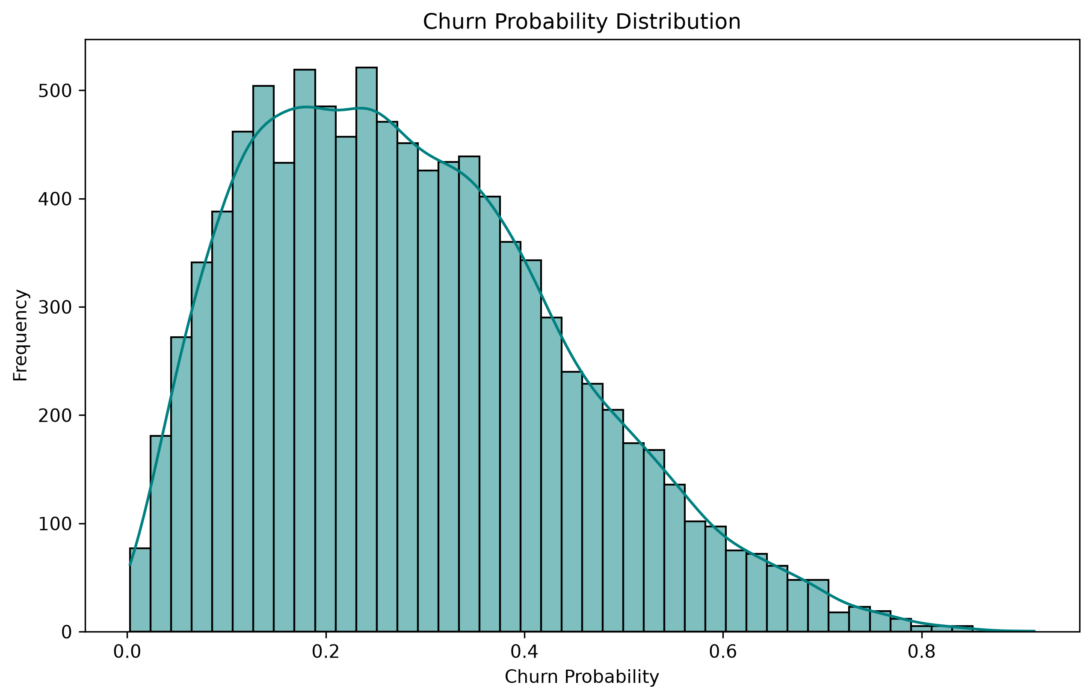
EDA – Rider behaviour Patterns.
EDA INSIGHTS
A. Churn Probability Distribution
Targeted retention should focus on the top 10–15% high‑risk riders
RideWise Analytics
Illustrative figures
05
Notes:
Churn Probability Distribution
Right‑skewed distribution
Most riders have churn probability between 0.1–0.4
Clear high‑risk tail above 0.60
Insight: Targeted retention should focus on the top 10–15% high‑risk riders.

Slide 9
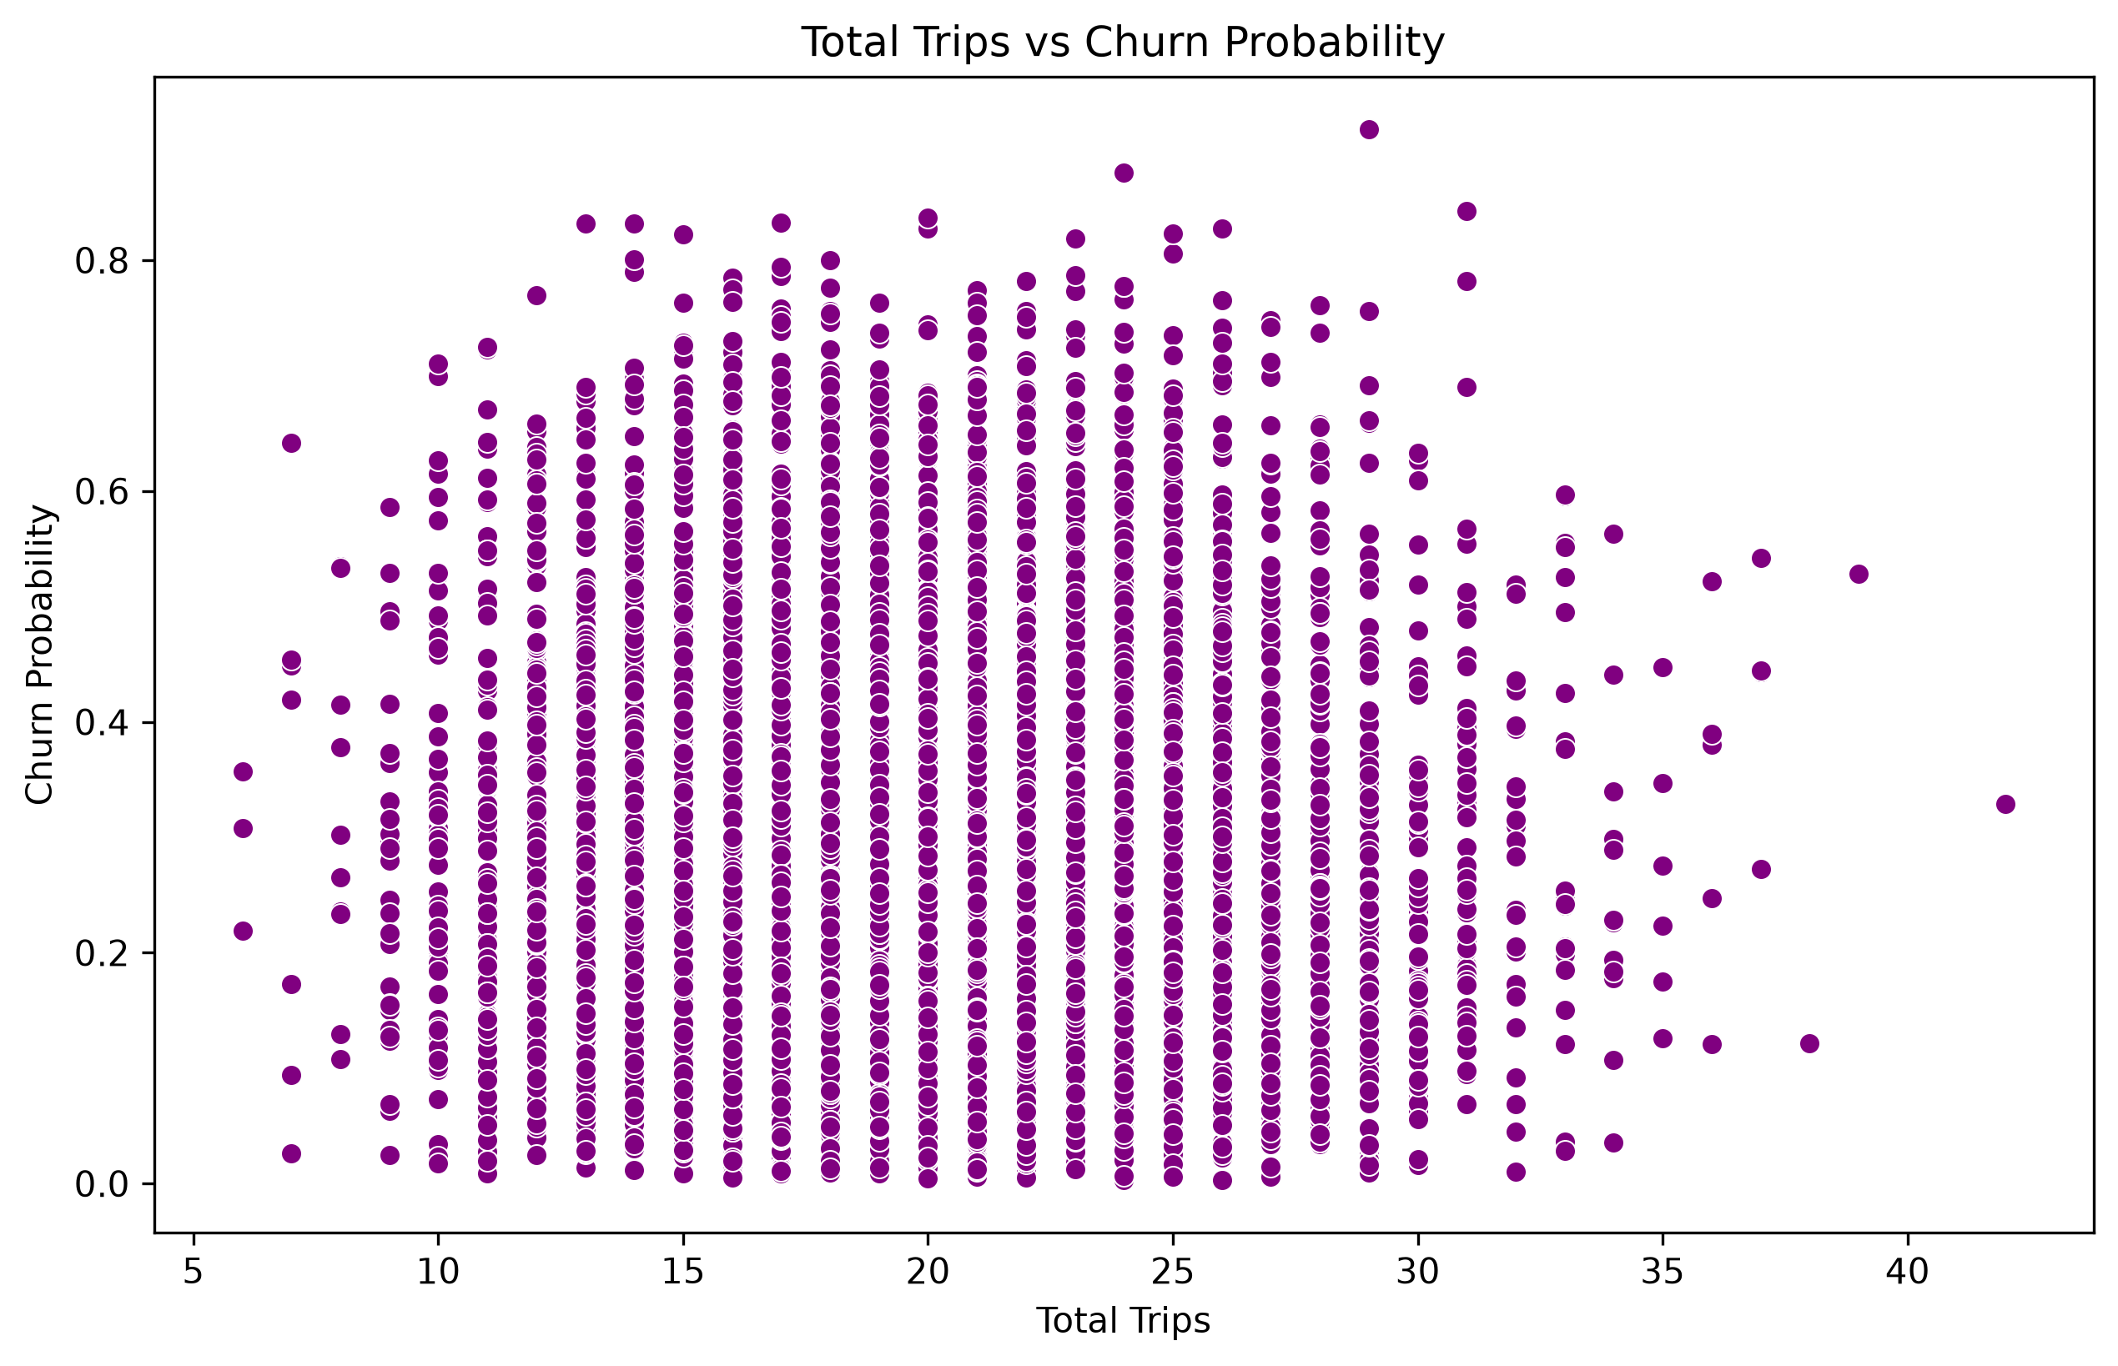
EDA – Engagement Trends.
EDA INSIGHTS
B. Engagement trend: total trips made.
Fewer trips, higher churn: Higher trips, lower churn
Trip Activity is a strong indicator of loyalty.
RideWise Analytics
Illustrative figures
05
Notes:
Total Trips vs Churn: Trip frequency is a behavioural churn driver.
More trips- more habit – more loyalty.
Low trip frequency → higher churn
High trip frequency → lower churn
Insight: Trip frequency is a strong loyalty indicator.
ach dot represents a rider.
The x‑axis shows how many trips the rider has taken.
The y‑axis shows their churn probability.
Most riders cluster between 10 and 30 trips, with churn probabilities between 0.15 and 0.35.
Riders with very few trips (6–12) show higher churn probabilities.
Riders with more trips (25–40) tend to have lower churn probabilities.
“This scatter plot shows a clear behavioural pattern: riders who take fewer trips are more likely to churn. Trip frequency is therefore a key feature for predicting churn and designing retention strategies.”

Slide 10
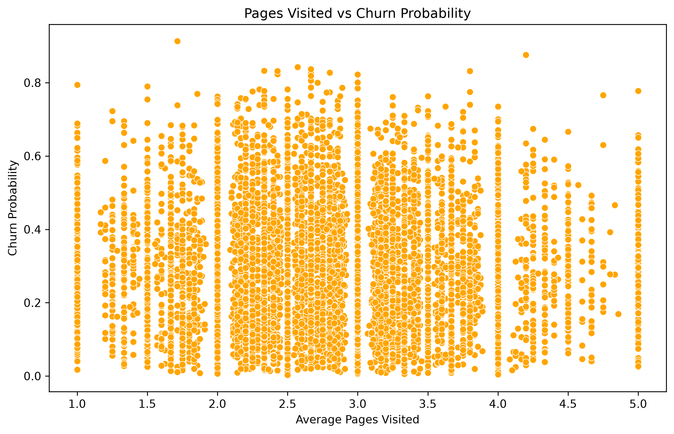
EDA INSIGHTS
EDA – ENGAGEMENT ANALYSIS.
C. Engagement Pattern pages visted
App Engagement: low engagement suggests a likelihood of churning.
Engagement + behaviour = core features for modelling.
RideWise Analytics
05
Illustrative figures
Notes:
Pages Visited vs Churn
Higher page views → lower churn
Low engagement strongly predicts churn
Insight: App engagement is the strongest churn driver.
Correlation Heatmap: Strongest churn predictors will be:
✔ Engagement
avg_pages_visited, conversion_rate, total_sessions
✔ Behaviour
total_trips, avg_fare
✔ Loyalty
loyalty_status (categorical, not in heatmap)
=== Age and surge pricing have weak correlations.
=== Engagement and behaviour are the core features for modelling.

Slide 11
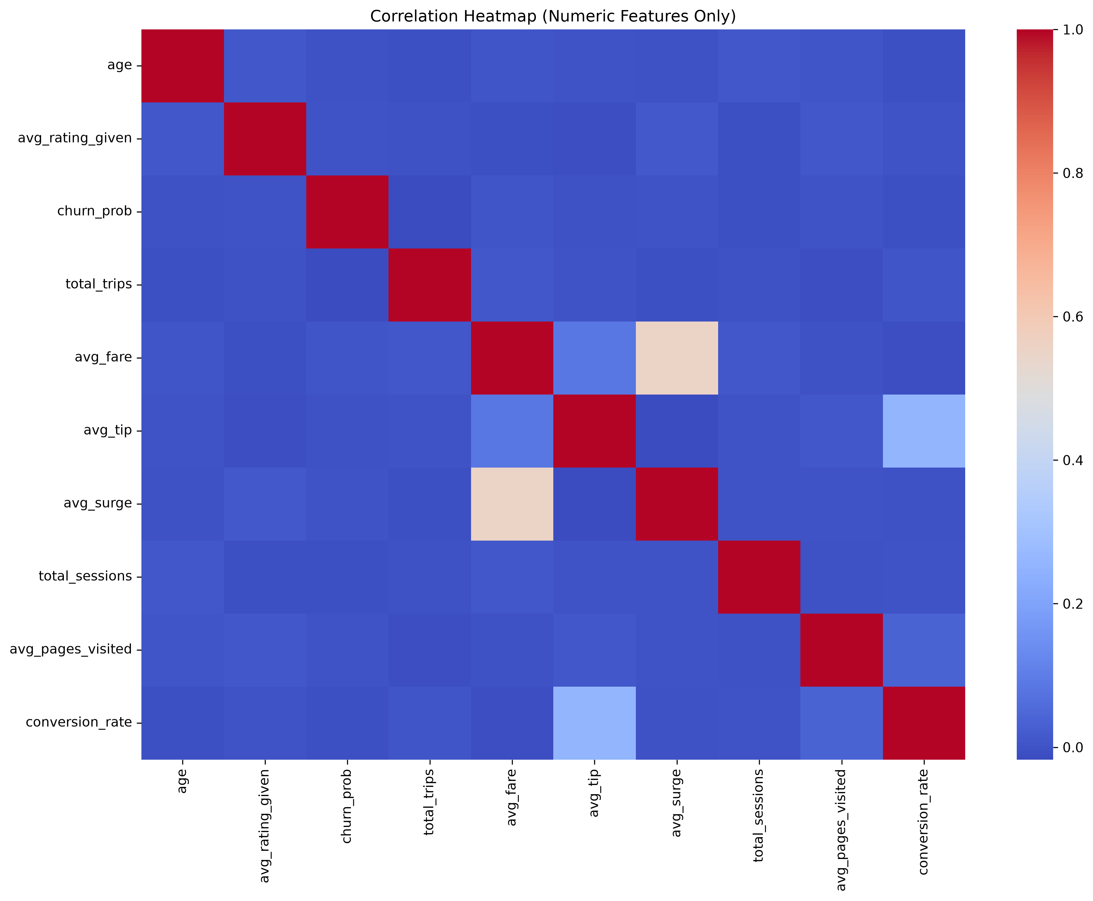
EDA – Churn Correlation.
EDA INSIGHTS
D. Heatmap.
App Engagement - low engagement suggests a likelihood of churning.
Engagement + behaviour = core features for modelling.
RideWise Analytics
05
Illustrative figures
Notes:
Engagement features (sessions, pages visited, conversion) strongly correlate with each other.
Engagement features correlate negatively with churn (higher engagement → lower churn).
Behavioural features (total trips, avg fare) moderately correlate with churn.
Age and surge have weak correlations.
“Engagement is the strongest driver of churn. Riders who use the app more and interact more are less likely to churn. Behavioural activity also matters, but demographics and surge pricing have little influence.”

Slide 12
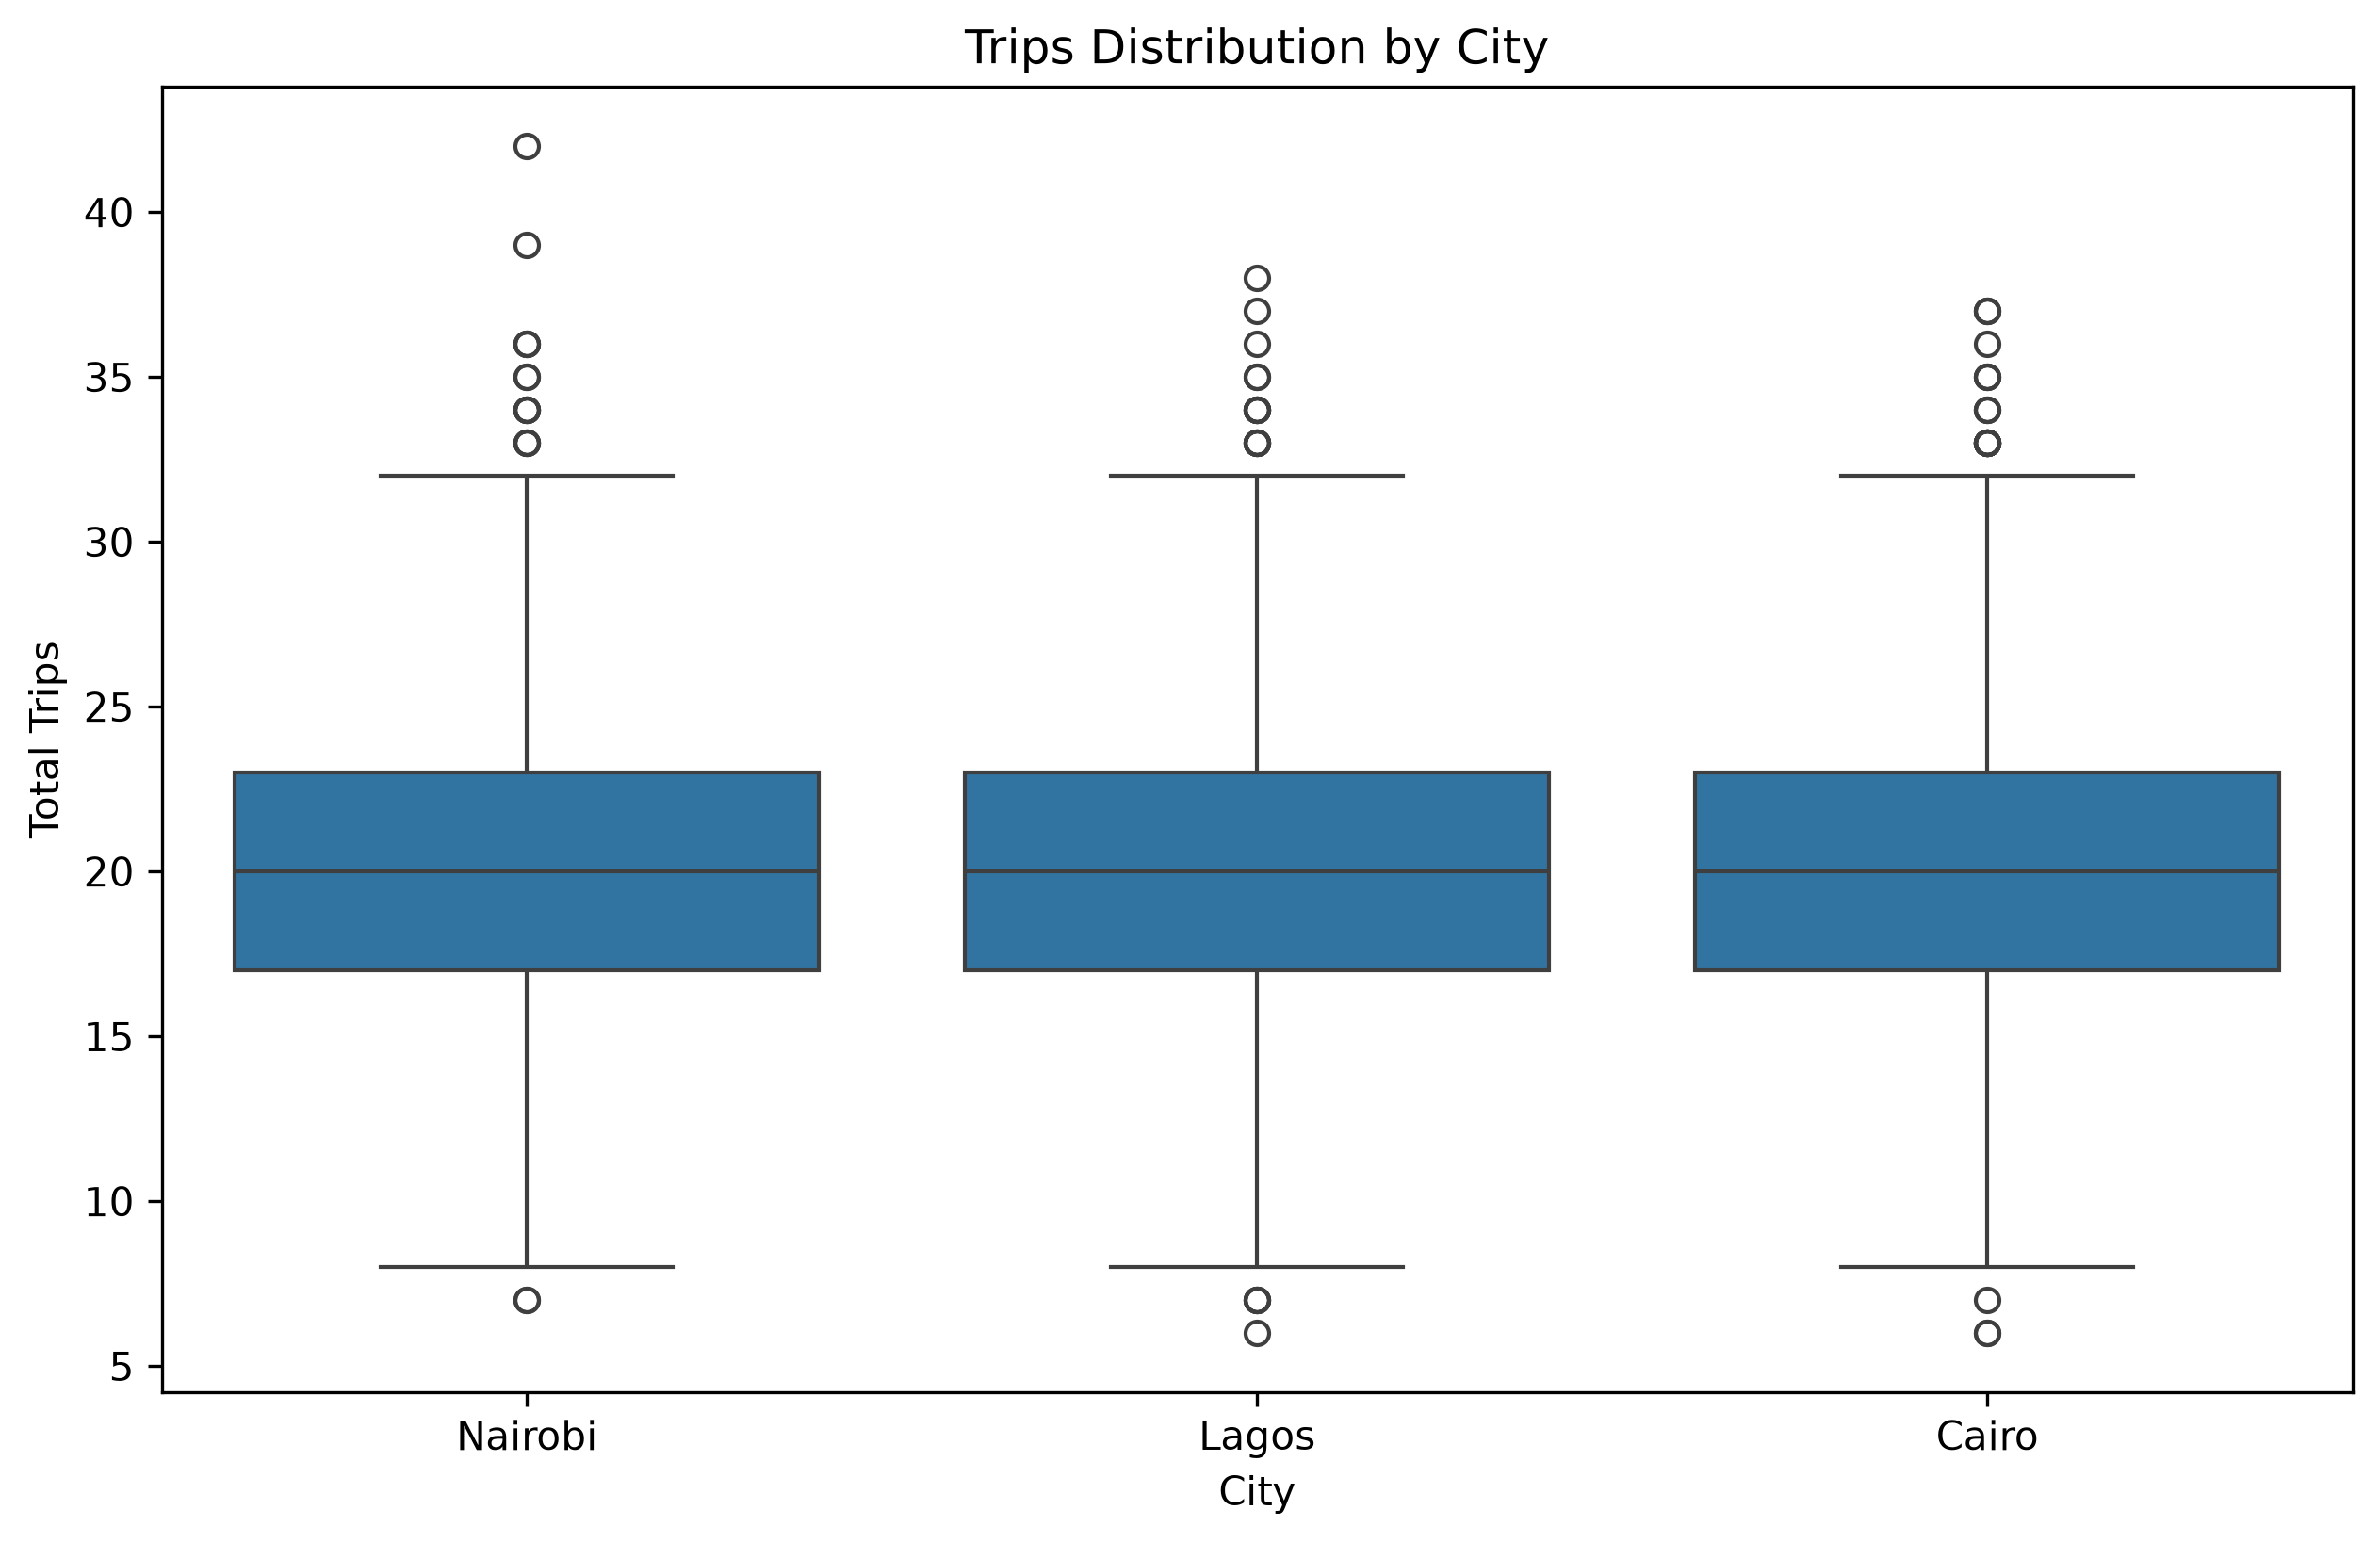
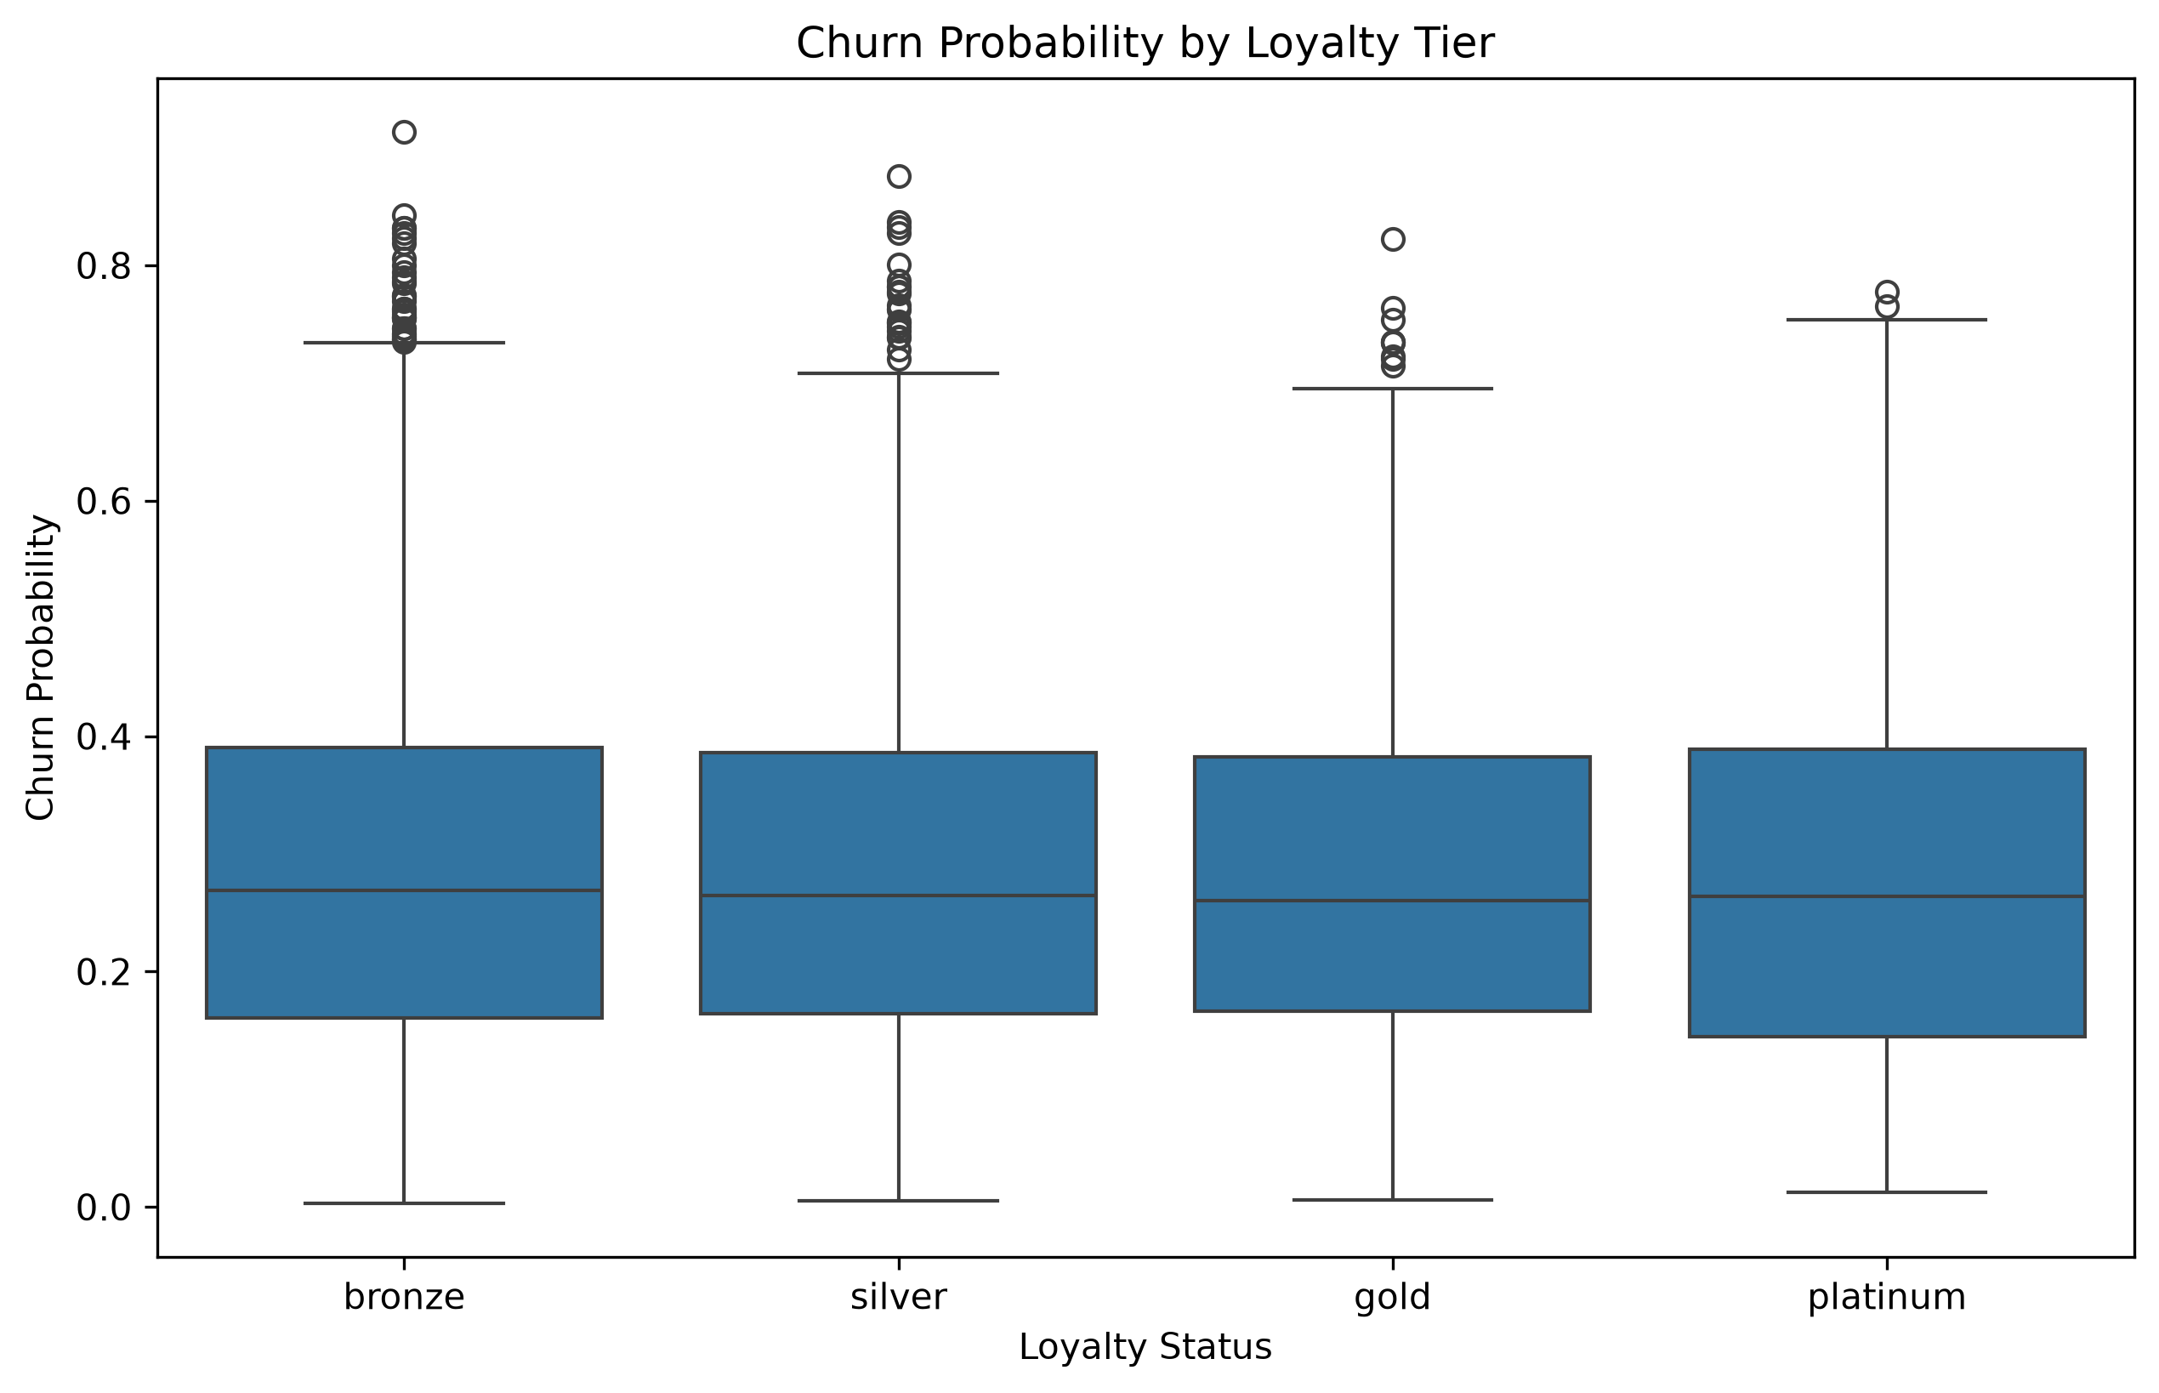
EDA INSIGHTS
EDA – Key Distributions: Loyalty and city.
F. City.
E. Loyalty Status
Bronze riders show the highest churn,
Silver moderate,
Gold/Platinum lowest
Engagement + behaviour = core features for modelling.
RideWise Analytics
05
Illustrative figures
Notes:
Churn Probability by Loyalty Tier
Bronze riders have slightly higher churn. Silver, Gold, and Platinum have similar distributions but fewer extreme outliers.
Loyalty tier still influences churn but not dramatically.
“Loyalty tier does affect churn, especially for Bronze riders. Higher tiers show more stability. This supports using loyalty tier as a feature in the model.”
Trips Distribution by City
All three cities have similar median trip counts (~20 trips).
There are outliers in every city (super‑active riders).
Cairo has slightly more variability.
“Trip behaviour is broadly similar across cities, but each city has its own spread and outliers. This means retention strategies may need slight city‑specific adjustments.”

Slide 13
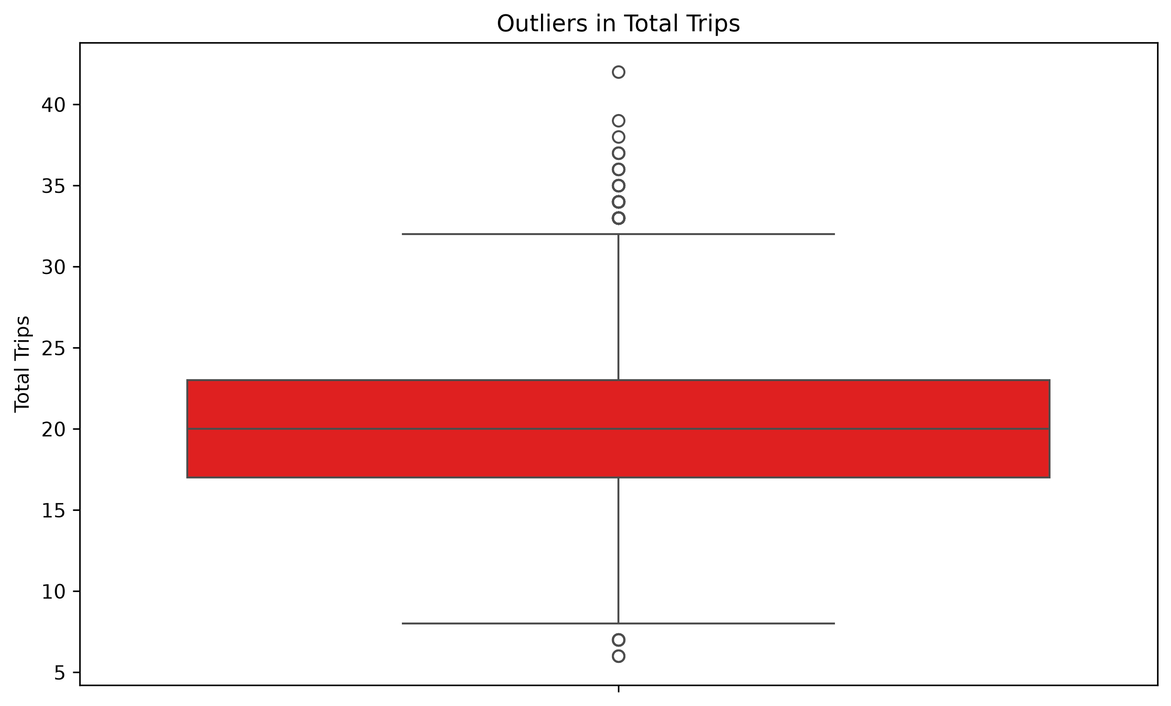
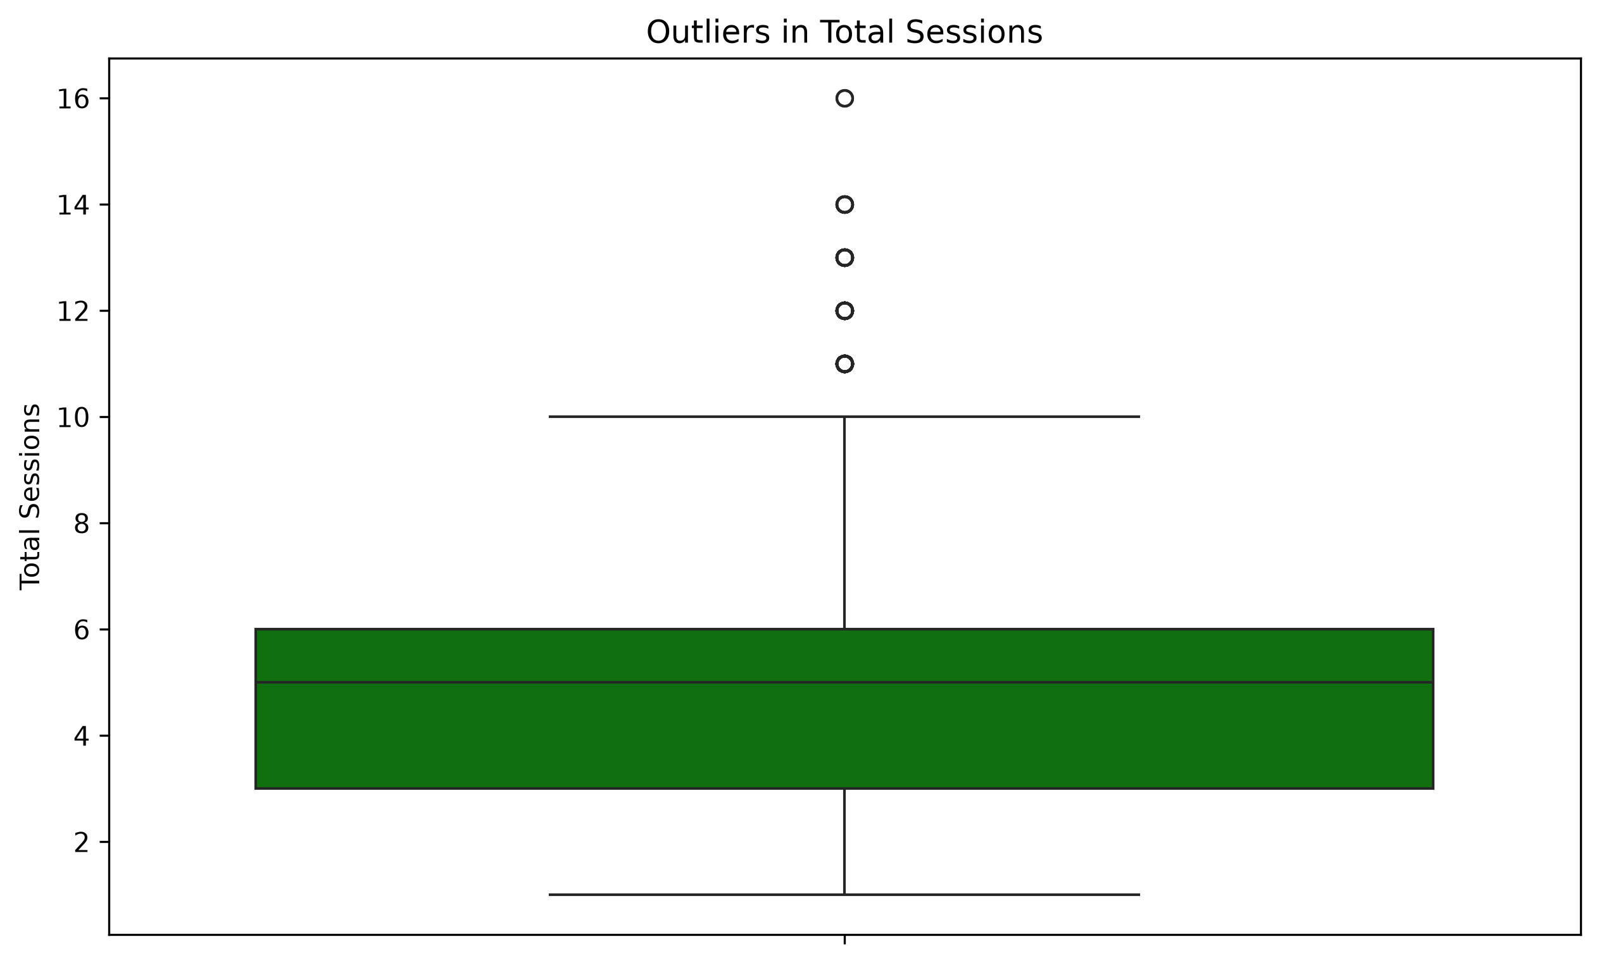
EDA INSIGHTS
EDA – Key Distributions: Outlier Detection.
G. Trips Outliers
H. Sessions Outliers.
Super‑active riders exist in the dataset. They are loyal and represent high lifetime value
High session riders are valuable and should be protected.
RideWise Analytics
05
Illustrative figures
Notes:
Outliers in Total Trips
Most riders take 17–23 trips. Some riders take 33–41 trips.
These are high‑value riders.
“Super‑active riders exist in the dataset. They are loyal and represent high lifetime value. Outliers must be handled carefully during modelling.”
Outliers in Total Sessions
Most riders have 3–7 sessions. Some riders have very high sessions (11–16).
These are heavy app users.
“High‑session riders are highly engaged and less likely to churn. Outliers represent super‑users who are valuable and should be protected.”

Slide 14
Predicting behaviour, engagement and loyalty
FEATURE ENGINEERING
BEHAVIOURAL DRIVERS
CONTEXT FEATURES
Recency
Loyalty Tier
Time since last completed ride.
Tenure and retention signals.
Frequency
Referral Flag
Ride volume over rolling windows.
Referred vs non-referred.
Monetary Value
City Encoding
Spend and average fare.
Geographic behaviour.
Engagement
Age Buckets
App sessions and interactions.
Life-stage segmentation.
Behavioural Scores
Cancellations and reliability.
Minimal, high-signal features that translate rider behaviour into clean numeric inputs the model can learn from.
Notes:
“EDA helped us understand the behavioural and engagement patterns that drive churn. Based on these insights, we engineered features such as recency, frequency, monetary value, engagement score, and loyalty encoding. These features allow the model to learn the underlying drivers of churn and make accurate predictions.”
Based on insights from EDA, we engineered features that capture rider behaviour, engagement, loyalty, and value.
Recency measures how long it has been since a rider last used the service. Frequency measures how often they ride. Monetary measures how much they typically spend. Engagement score combines sessions, pages visited, and conversion rate. Loyalty encoding converts Bronze/Silver/Gold/Platinum into numeric values. Referral flag identifies riders referred by others. City encoding captures geographic differences. Age buckets group riders into meaningful age categories. Missing‑session flag identifies riders with incomplete engagement data.
These engineered features translate real rider behaviour into numeric inputs the model can learn from, improving prediction accuracy and reducing overfitting.”

Slide 15
What the data reveals- Business Implications
EDA INSIGHTS
Encourage low‑activity riders to take more trips through promotions.
Protect high‑activity riders with loyalty rewards.
Use trip frequency as a core metric in retention dashboards.
RideWise Analytics
Illustrative figures
05

Slide 16
Model performance: Enhance performance.
CHURN MODEL
Model | Accuracy | Precision | Recall | F1 | AUC
Decision Tree | 0.582 | 0.348 | 0.337 | 0.343 | 0.518
KNN | 0.632 | 0.360 | 0.180 | 0.240 | 0.518
Bagging | 0.658 | 0.342 | 0.062 | 0.105 | 0.515
Random Forest | 0.665 | 0.346 | 0.042 | 0.075 | 0.513
Logistic Regression | 0.496 | 0.323 | 0.511 | 0.396 | 0.510
XGBoost | 0.666 | 0.323 | 0.031 | 0.056 | 0.509
Gradient Boosting | 0.675 | 0.421 | 0.012 | 0.024 | 0.502
SVC (RBF) | 0.676 | 0.000 | 0.000 | 0.000 | 0.501
ExtraTrees | 0.646 | 0.313 | 0.079 | 0.126 | 0.499
AdaBoost | 0.677 | 0.000 | 0.000 | 0.000 | 0.495
Best model by AUC: Decision Tree (0.582). Metrics on a 0–1 scale; rows ranked by AUC.

Slide 17
Classification Report: Churners and Non-churners.
CHURN MODEL
Class | Precision | Recall | F1-score | Support
Non-churners (0) | 0.69 | 0.70 | 0.69 | 1,354
Churners (1) | 0.35 | 0.34 | 0.34 | 646
Accuracy | – | – | 0.58 | 2,000
Macro avg | 0.52 | 0.52 | 0.52 | 2,000
Weighted avg | 0.58 | 0.58 | 0.58 | 2,000
Class distribution by support
What this means
Strong on non-churners (F1 0.69) — the majority class, with plenty of examples to learn from.
Weaker on churners (F1 0.34) — the minority class is harder to detect: fewer riders and less consistent patterns.
68% non-churners vs 32% churners — a heavily imbalanced dataset.
Class key: 0 = Non-churners, 1 = Churners. Support = number of riders per class in the test set (n = 2,000).

Slide 18
Model performance: SMOTE, Class weighting, threshold optimisation, and Optuna hyperparameter tuning.
CHURN MODEL
Model | Accuracy | Precision | Recall | F1 | AUC
Logistic Regression | 0.496 | 0.323 | 0.511 | 0.396 | 0.510
Decision Tree | 0.582 | 0.348 | 0.337 | 0.343 | 0.518
KNN | 0.632 | 0.360 | 0.180 | 0.240 | 0.518
ExtraTrees | 0.646 | 0.313 | 0.079 | 0.126 | 0.499
Random Forest | 0.665 | 0.346 | 0.042 | 0.075 | 0.513
Gradient Boosting | 0.675 | 0.421 | 0.012 | 0.024 | 0.502
SVC (RBF) | 0.676 | 0.000 | 0.000 | 0.000 | 0.501
AdaBoost | 0.677 | 0.000 | 0.000 | 0.000 | 0.495
Best model by F1 (0.396).
Best Model (after tuning): Random Forest.
Optimal Threshold: 0.126 (F1 = 0.489).

Slide 19
Classification Report: After Tunning.
CHURN MODEL
Class | Precision | Recall | F1-score | Support
Non-churners (0) | 1.00 | 0.00 | 0.00 | 1,354
Churners (1) | 0.32 | 1.00 | 0.49 | 646
Accuracy | – | – | 0.32 | 2,000
Macro avg | 0.66 | 0.50 | 0.25 | 2,000
Weighted avg | 0.78 | 0.32 | 0.16 | 2,000
Class distribution by support
What this means
Catches every churner (recall 1.00) — but only by flagging almost everyone, so precision on churners falls to 0.32.
Misses non-churners completely (F1 0.00) — the model labels virtually all riders as churn, dragging accuracy down to 0.32.
Threshold optimisation cannot fix poor probability separation.
68% non-churners vs 32% churners — an imbalanced dataset.
The model now flags every churner (recall 1.00), but with precision of just 0.32 most alerts are false alarms.
Class key: 0 = Non-churners, 1 = Churners. Support = number of riders per class in the test set (n = 2,000).
Notes:
Classification Report:
precision recall f1-score support
0 1.00 0.00 0.00 1354
1 0.32 1.00 0.49 646
accuracy 0.32 2000
macro avg 0.66 0.50 0.25 2000
weighted avg 0.78 0.32 0.16 2000

Slide 20
Why choose the Random Forest model?
CHURN MODEL
0.499
0.323
1.000
0.489
ROC-AUC
Ranking separability
Precision
Share of flags that churn
Recall
Every churner caught
F1 score
Precision–recall balance
Algorithm: Random Forest · Interpretation: SHAP (Shapley Additive Explanations) and Mutual Information (MI)
RideWise Analytics
07

Slide 21
What doesn’t predict churn?
CHURN MODEL
Relative importance — every factor, ranked
What this tells us
The tall teal bars drive churn. The four grey bars don’t.
Loyalty tier, engagement, average fare and age band each scored zero — on their own they tell us nothing about who leaves.
RideWise Analytics
09
Notes:
Age is the biggest clue to who might leave, making up about 40% of the picture.
How often someone rides and their city come next. Whether they were referred matters least

Slide 22
Experiment tracking & registry
MLFLOW
01
02
03
Experiment tracking
Model registry
Versioning
Log parameters, metrics and artifacts for every run.
Register champion models in a central store.
Promote versions across staging and production.
120+ runs tracked
8 models registered
100% reproducible
RideWise Analytics
10

Slide 23
Real-time scoring with FastAPI
API DEPLOYMENT
Client
FastAPI
Model
Sends rider features
Real-time scoring service
Returns churn probability
Input / output example
POST /predict
Request { "rider_id": 10432, "recency": 12, "frequency": 8, "tenure": 3 }
Response { "churn_probability": 0.87, "segment": "At-Risk" }
RideWise Analytics
11

Slide 24
Keeping the system healthy
MONITORING
1
2
3
Drift detection
Performance tracking
Dashboard
Track feature and prediction drift against training baselines.
Monitor live AUC, precision and recall over time.
Churn risk, segments and KPIs in one live view.
RideWise Analytics
12

Slide 25
Impact and the road ahead
CONCLUSION
01
02
03
Business impact
Next steps
Scalability
Earlier churn signals enable targeted retention and higher rider lifetime value.
A/B test interventions and expand features with real-time streaming data.
Containerised services and automated retraining scale across cities.
Thank you · Oluwatosin Abraham— Data Analytics & Machine Learning
RideWise Analytics
13

Slide 26
THANK YOU
OLUWATOSIN ABRAHAM

Slide 27
QUESTIONS

Slide 28
Stopped here.

Slide 29
KMeans rider clusters
SEGMENTATION
24%
31%
27%
18%
Champions
Loyal Riders
At-Risk
Hibernating
Business action
Business action
Business action
Business action
Reward & retain
Nurture loyalty
Targeted win-back
Re-activation offers
Segment profiles built from RFM and behavioural features · silhouette score 0.61.
RideWise Analytics
Illustrative figures
08

Slide 30
Scoring, ranking & insights
DRIVER PERFORMANCE
4.8 / 5
92%
88%
Avg rating
Acceptance rate
On-time pickups
4.1%
Top 10%
3.2K
Cancellation rate
Elite performers
Ranked drivers
RideWise Analytics
Illustrative figures
09

Slide 31
PLOTS, WHICH GAVE ME THE DECISION TREE AS THE BEST MODEL.

